Slide 1
NAPCORE – the National Access Point Coordination
Organisation for Europe
Timo Hoffmann
NAPCORE / German Federal Highway and Transport Research Institute
SIS 5

Slide 2

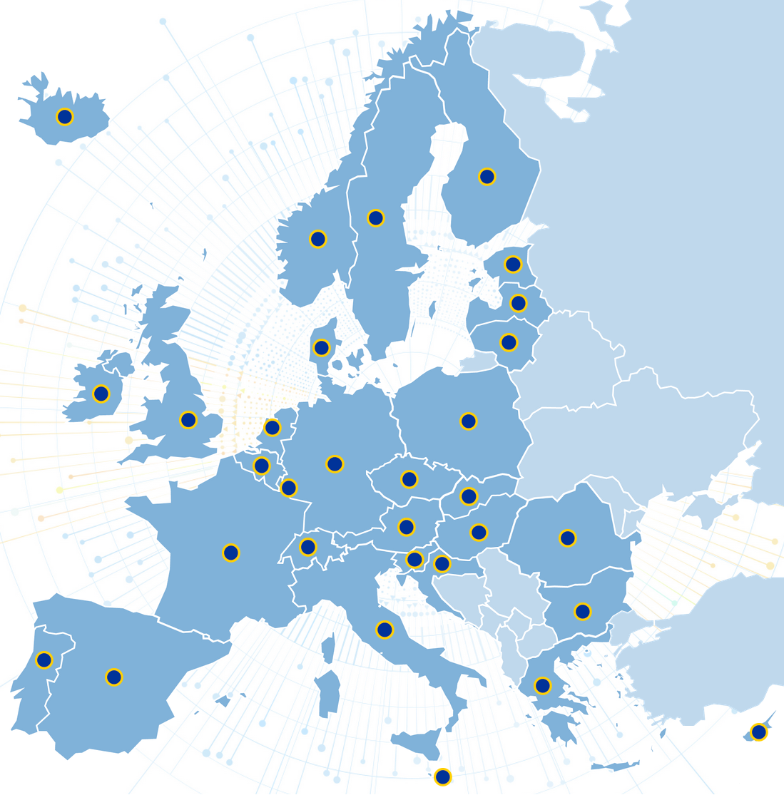
Pan-European coordination on Mobility Data
NAPCORE is:
a project/initiative/organisation (co-)funded
(€21.5m) by the European Commission
covering most of Europe (all EU MS + 6 countries)
currently about to start the second phase,
NAPCORE’s first funding phase is ending in June
the only pan-European project dealing with
mobility data for traveller information
working on data standardisation (DATEX II,
TN-ITS, NeTEx, SIRI) and interoperability
of National Access Points for harmonized
mobility data access throughout Europe

Slide 3
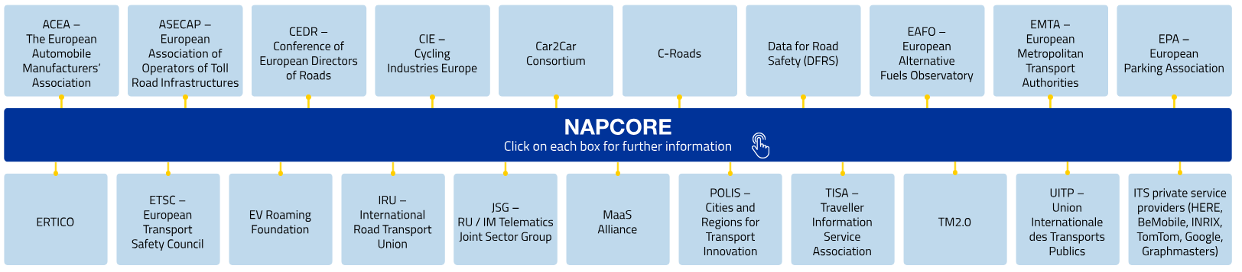

NAPCORE achievements so far
NAPCORE has achieved in its first phase 2021-2025 (excerpt):
Bringing Europe together with a governance and working structure
Strong stakeholder engagement via Advisory Board (see graphic) and
Cooperation
Agreements
(with EPA, CIE,
POLIS, C-Roads,
DFRS)
Created a first metadata catalogue specification for mobility data platforms (not only NAPs) to enable interoperable discoverability of data: mobilityDCAT-AP

Slide 4
NAPCORE achievements so far (cont’d)
Joint Position Papers on the revisions of the ITS Directive, the MMTIS Delegated Regulation, the planned SRTI revision (to be published in June)
Work on data standards included the merger of TN-ITS and DATEX II, a common harmonization roadmap, new versions of the standards
First version of an ITS Data Dictionary to create a common understanding
Creation of a NAP Level of Service KPI Framework for NAP harmonisation
Several demonstrators showcased use-case based NAP interoperability
National Body harmonisation by creating common forms and processes for compliance assessment
158 milestones achieved by >70 partners and >500 experts

Slide 5
NAPCORE next steps
Second funding phase about to start in July 2025 until December 2027
Set up of a sustainable long-term governance for the time after 2027
Consortium of 77 partners from 33 countries, funded (85%) by DG MOVE
Main goal: EU Member State coordination on ITS Directive data topics
More focus on data and data standards for multimodal mobility
More focus on community & domain management for stakeholder input and engagement to foster data provision and use
Creation of national implementation roadmaps (implementing NAPCORE recommendations on national level in NAPs and National Bodies)

Slide 6
Timo Hoffmann
German Federal Highway and Transport Research Institute
hoffmannt@bast.de
bast.de - napcore.eu

