Slide 1
Accessibility and Quality of Alternative Fuels Data
Lígia Conceição
Senior ITS Consultant, Armis & NAPCORE
SIS10 - Alternative Fuels Infrastructure Regulation (AFIR) and its new Delegated and Implementing Acts on Data

Slide 2
Agenda
NAPCORE context on Alternative Fuels
Alternative Fuels Demonstrator
Data Quality Framework for Alternative Fuels

Slide 3
NAPCORE context on Alternative Fuels
Limited availability of AF data on the NAPs
  Only 13 out of 30 had any sort of AF data on the NAPs (survey below)
  Hindering the discoverability of such data by service providers
Different initiatives supported by the EC to improve this scenario
  Sustainable Transport Forum and respective sub-groups dedicated to AF data
  Establishment of a Common European Access Point for AF data
  Alternative Fuels Demonstrator (NAPCORE WG2)
  Data Quality Framework for Alternative Fuels (NAPCORE WG3)
Internal survey for the development of NAPCORE AF demonstrator (April, 2023)
Notes:
Focus on the outlined expressions…

Slide 4
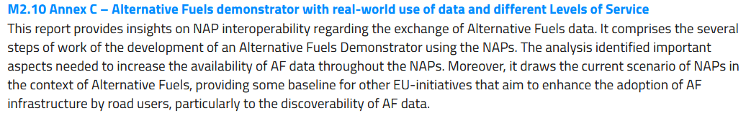
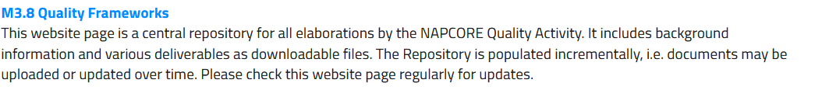

NAPCORE context on Alternative Fuels
https://napcore.eu/
Alternative Fuels Demonstrator (WG2 - Task 2.4)
Data Quality Framework for Alternative Fuels (WG3 - Task 3.2)

Slide 5
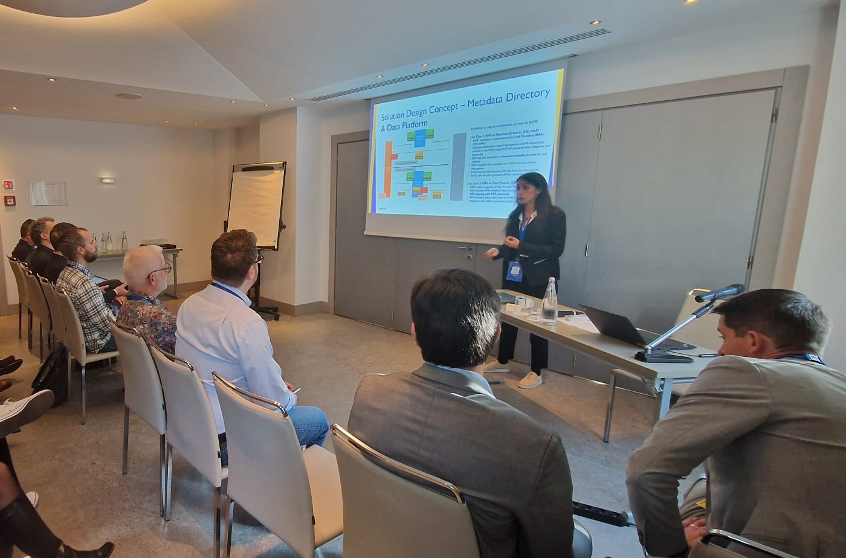
Alternative Fuels Demonstrator
Purpose of the Demonstrator
Conceptualization
Use Case 1.2 - FILTER THE AVAILABLE DATA BY CATEGORY
Challenges and Lessons Learnt
Alternative Fuels Demonstrator
Live demonstration
NAPCORE Mobility Data Days, Turin, 2024

Slide 6
Alternative Fuels Demonstrator
1. Purpose of the Demonstrator
Prove-of-value for “mobilityDCAT-AP” metadata spec
Explore the required elements for the development of a common EU Access Point for alternative fuels data, creating a common interface that would act as a data gateway linking all MS NAPs in a single web platform
Consider EAFO as the web platform that would host this common EU Access Point in the future, which as part of its current development and evolution would be equipped with the corresponding technical elements to this end
Notes:
What work was done
What are the main limitations that are feared
What are the current NAP limitations in terms of data
Solution Design –current proposed
Currently according to … (Ligia)
The demonstrator should explore how both static and dy
namic could be made available and accessible at European level, without creating storing duplicities with Member States’ NAPs repositories, considering NAP format and need for harmonisation (linked to other WG activities).
The demonstrator should consider EAFO as the web platform that would host this common EU Access Point in the future, which as part of its current development and evolution would be
Explore how both static and dynamic could be made available and accessible at European level, without creating storing duplicities with Member States’ NAPs repositories, considering NAP format and need for harmonisation (linked to other WG activities)
equipped with the corresponding technical elements to this end

Slide 7
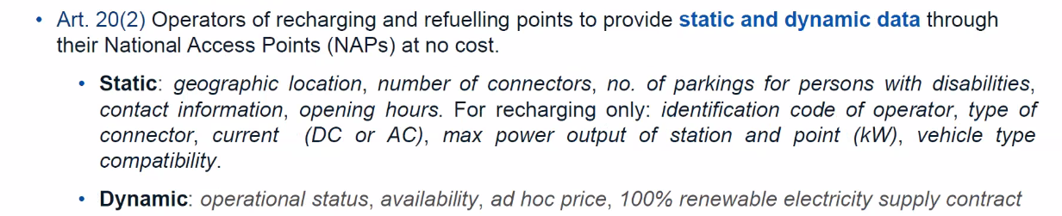
Alternative Fuels Demonstrator
Alternative Fuels data can be defined as data related to:
availability of recharging points and stations for electric vehicles; ​
availability of refuelling points and stations for alternative fuel types (Hydrogen, LNG, CNG,…) ​
location of recharging points for electric vehicles and the conditions for their use;
Data Provision (DR 2023/1804 – AFIR Art.20)
Notes:
A Descrição de 2023
Availability of Alternative fuels Data
Limitations of the demonstrator
Related Works
geographic location of the recharging points and refuelling points for alternative fuels,
number of connectors,
number of parking spaces for people with disabilities,
contact information of the owner and operator of the recharging station and refuelling station,
opening hours;
further static data for publicly accessible recharging points operated by them:
ID codes, at least of the recharging point operator,
type of connector,
type of current (AC/DC),
maximum power output (kW) of the recharging station,
maximum power output (kW) of the recharging point,
vehicle type compatibility;
dynamic data for publicly accessible recharging points and refuelling points for alternative fuels operated by them:
operational status (operational/out of order),
availability (in use/not in use),
ad hoc price,
electricity supplied is 100 % renewable (yes/no).

Slide 8
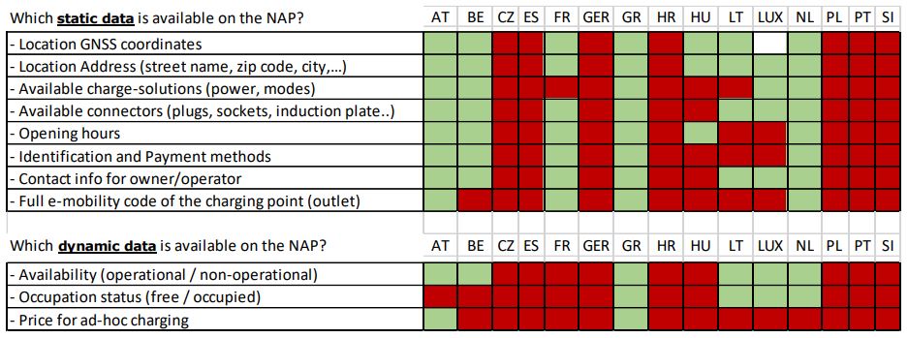
Alternative Fuels Demonstrator
Implementation status – Survey from the IDACS project in 2020
Regarding EV charging points, this was the scenario found for static and dynamic data availability:
Notes:
Member states must have a NAP for AF available by the 1st of January 2025
Charging Point Operators must deliver their data to the NAP by April 2025

Slide 9
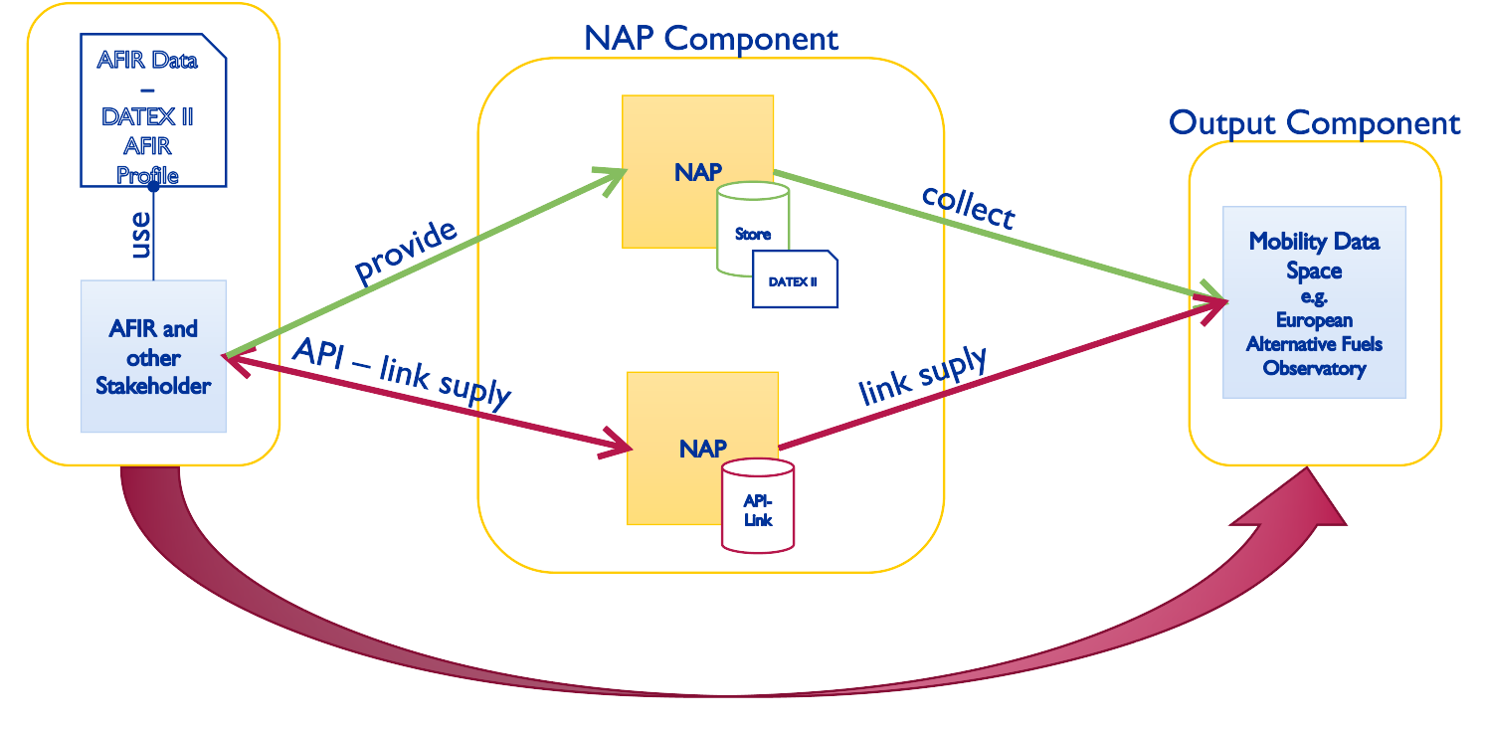
Alternative Fuels Demonstrator
2. Conceptualization
Initial demonstrator Proof-of-concept

Slide 10
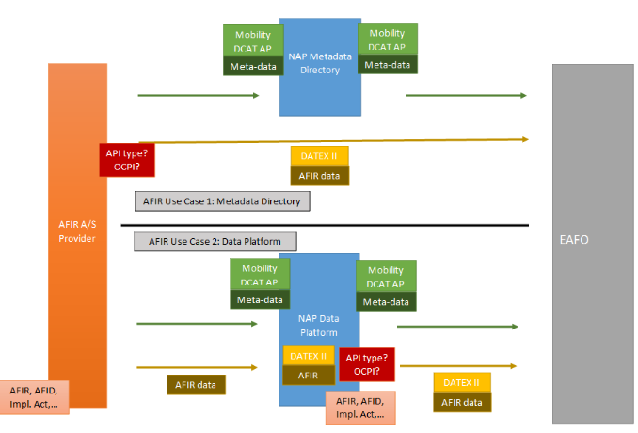
2. Conceptualization
Solution Design – Metadata Directory & Data Platform
Alternative Fuels Demonstrator
Possibility to test an architecture on how an EAFO
Use Case 1: NAP as Metadata Directory (MD-NAP)
EAFO maintains a comprehensive list of all Metadata NAPs (MD-NAPs).
National stakeholders submit descriptions of AFIR-related data services to the NAP, using DCAT-AP standards (data categories and keywords).
NAP lists this metadata in a machine-readable format for easy retrieval.
EAFO requests the metadata from NAP to access service descriptions.
EAFO extracts the necessary API link from the data provider.
EAFO uses the data provider's API for streamlined data access.
Use Case 2: NAP as Data Platform (DP-NAP)
EAFO holds a registry of Data Platform NAPs (DP-NAPs).
NAP provides AFIR-compliant data directly to EAFO via a free API, aligning with STF recommendations.
EAFO directly utilizes data from the NAPs, enabling seamless data integration and uniform access across EU infrastructure platforms.

Slide 11
Alternative Fuels Demonstrator
Revisiting AF Data Availability
Implementation status – Internal survey (April 2023)
A deep research regarding the availability of AF data on the NAPs was carried out by the PT team as part of the work related to the AF demonstrator (task 2.4)
It pointed out that 13 MS (out of 30) have some sort of AF data
However, only a few of those had their datasets clearly organized according to the CKAN, which allows them to integrate the Metadata demonstrator more easily
The table below summarizes this information
No data was found
Some data was found
Only 4 NAPs had usable data for POC

Slide 12
Alternative Fuels Demonstrator
3. Use Case 1.2 - FILTER THE AVAILABLE DATA BY CATEGORY
Definition: As a Service Provider, to have access to up-to-date metadata that is organized according to a certain category/topic (e.g. Alternative Fuels) so that the characteristics of said dataset (format of the data, updated timeframe) can be analysed.
Preparatory Stage:
  Characterization of the Category defined by the usage of the terms:
    Electric Vehicle
    Charging station / CPO
    Hydrogen
    LNG / CNG
  Note: did not consider additional terminologies for similar Alternative Fuels concepts nor Language variations

Slide 13
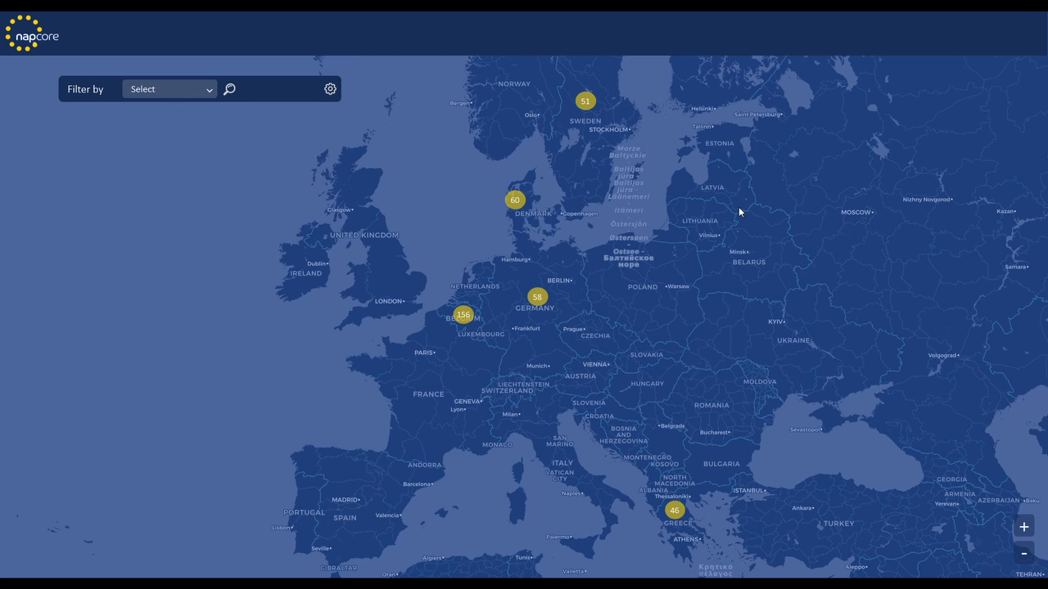
Alternative Fuels Demonstrator
3. Use Case 1.2 - FILTER THE AVAILABLE DATA BY CATEGORY
About 10 datasets of returned results
The full text search - a text search index for a specific term or phrase - using the Title and Description field provided acceptable results
Validate the flexibility of metadata in increasing data discoverability: in this case the lack of data
Data discoverability can be used both in metadata repository as well as in data platform NAP types, as long as there is a public available access to the datasets metadata
Notes:
Versioning of metadata

Slide 14
Alternative Fuels Demonstrator
Available Information on AF Data Providers with regards to:
  Type of Data
  Interface to Extract Data
  Data Format & version – conformity with Datex II
  Data Category
  Contact Person
  Privacy (is it Publicly available?)
  Refresh rate of dynamic data
  Is there any additional data what is available, but not shared free of charge (eg. Only for registered members)
  Assurance of quality of the data
  Challenges getting the Data from Access Points
  How to cope with different data standards and Versions? (OCPI,...)

Slide 15
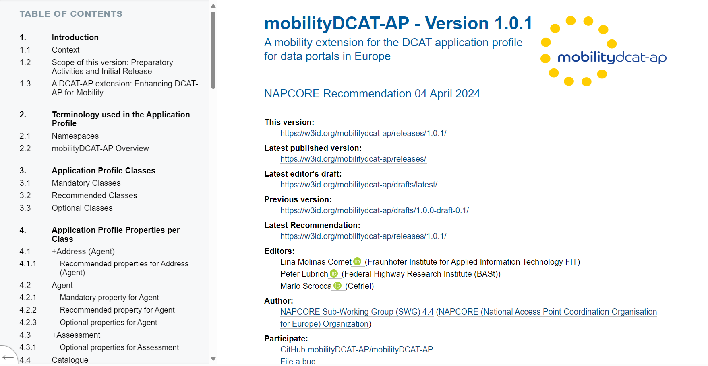
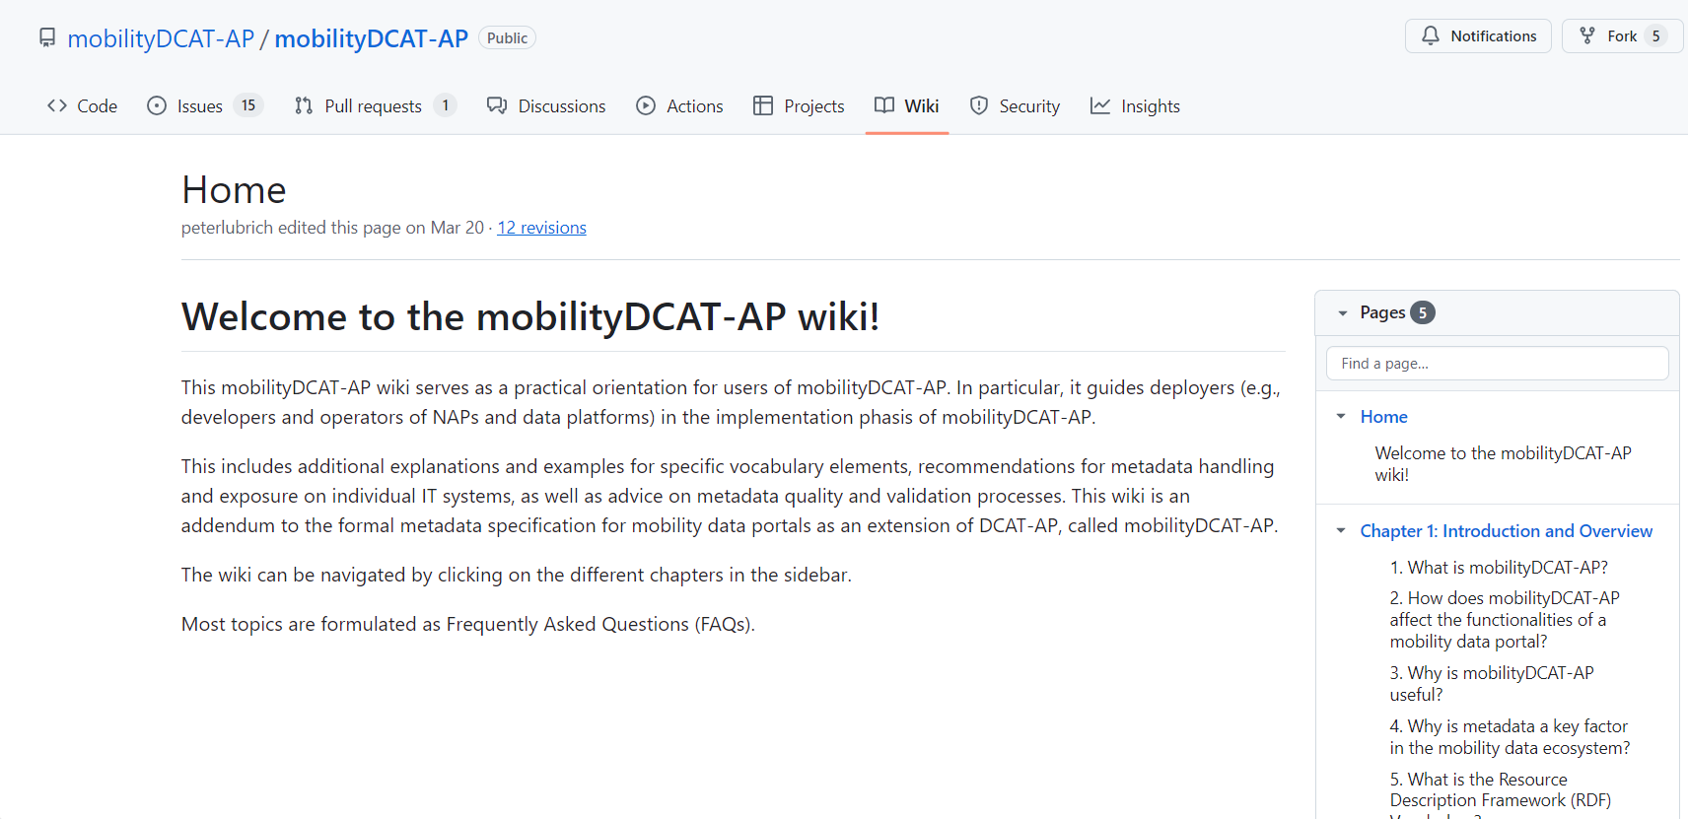
Alternative Fuels Demonstrator
mobilitDCAT-AP: a metadata specification for National Access Points and other mobility data portals
Outcomes: conceptual model, logical model, technical documentation, user support, maintenance & governance
Target group: deployers and hosts of European NAPs and other data portals
The latest mobilityDCAT-AP specification:
  https://w3id.org/mobilitydcat-ap
mobilityDCAT-AP main repositories:
  mobilityDCAT-AP · GitHub
Notes:
main repositories:Controlled vocab
mobilityDCAT-AP Generator Tool
Filling and charging stations
Availability of charging points for electric vehicles
Availability of filling stations
Location and conditions of charging points
Location and conditions of filling stations

Slide 16
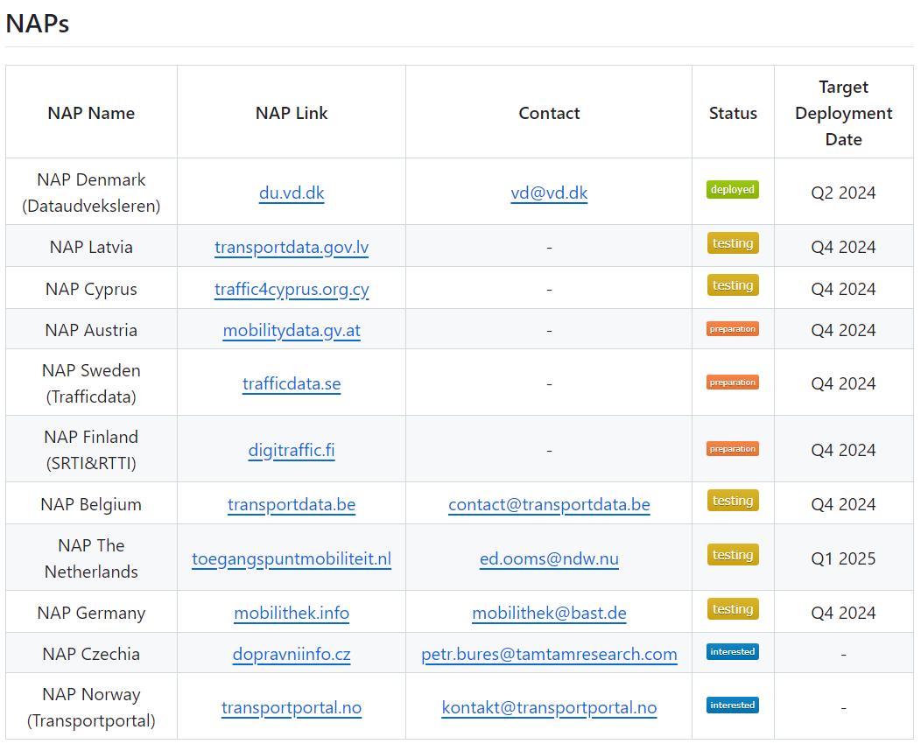
Alternative Fuels Demonstrator
Metadata Inventory
Comparison
MORE INFO
GitHub - mobilityDCAT-AP/adopters: List of adopters of the mobilityDCAT-AP specification
NAP | # of datasets August 2022 | DCAT-AP schema ? | # of datasets October 2024 | MobilityDCAT-AP status
Trafficdata.se* | 49 | DCAT-AP + extensions („ext: …“) | 51 | preparation
du-portal-ui.dataudveksler.app.vd.dk | 26 | DCAT-AP | 95 | deployed
transportdata.be | 176 | DCAT-AP | 123 | testing
data.nap.gov.gr | 34 | DCAT-AP | 47 | -
mobilithek.info | > 7000 | Proprietary RDF model, compatible with IDS and DCAT-AP + extensions („mdp: …“) | > 9000 | testing
mobilitydata.gv.at | 40 | Proprietary XML model | 47 | preparation

Slide 17
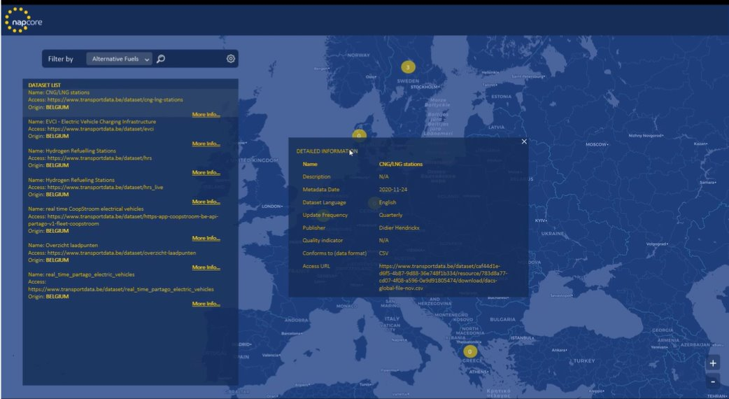
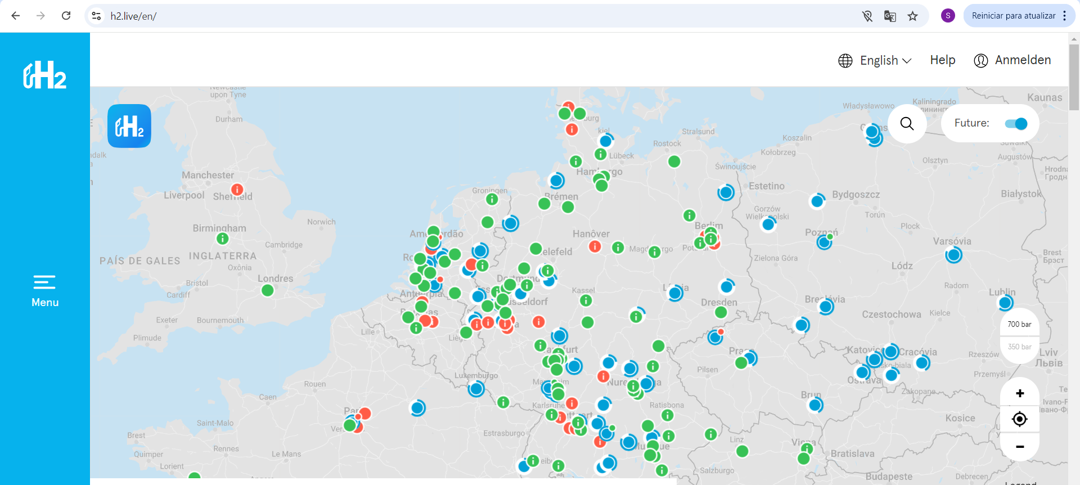
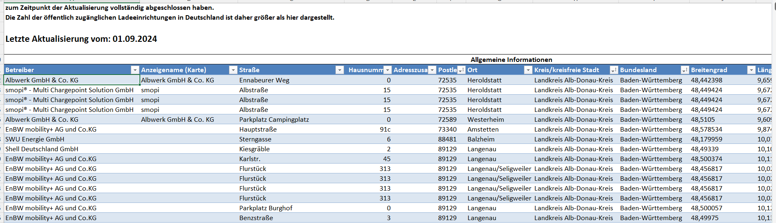
Alternative Fuels Demonstrator
4. Challenges and Lessons Learnt
Challenging to extract datasets - data must be freely available to be extracted
Data described in Local languages
Duplicate data Across countries
  Comparison of sources as identifier (e.g. H2 Mobility)
  Comparison of type of data, format
    IF metadata is harmonized duplicates will be easier to identify
EV charging points data has a higher availability compared to hydrogen and other AF fuelling infrastructure.
mobilitydcatap:mobilityTheme used in DK NAP made it easier to identify the existence/availability of AF data!
Notes:
Filling and charging stations
Availability of charging points for electric vehicles
Availability of filling stations
Location and conditions of charging points
Location and conditions of filling stations

Slide 18
Alternative Fuels Demonstrator
4. Challenges and Lessons Learnt
Challenges faced in making AF data available
AF data availability depends on the provision by the CPOs
MS mandated CPOs to provide AF data through their NAPs
Different NAP Architectures and other issues prevent CPOs from adding such data
For that reason, much of the data still lacks in several NAPs and MS (as observed in the status of implementation)
Possible solution: common EU access point for AF data
EC has established that by 31 December 2024, MS shall ensure that AF data is made accessible on an open and non-discriminatory basis to all data users through their NAPs
EC has established that – by 2027 – there shall be a common EU access point for AF data
Technical details of such a platform are still to be defined.
Harmonize structure of metadata across EU MS
Introduce a versioning control of the metadata of datasets across NAPs
Security (registration of the data in the dataspace)
Multiple NAP Metadata Schemes (mostly DCAT-AP)
harmonized/ European NAP Metadata Scheme (mobilityDCAT-AP)

Slide 19
Data Quality Framework for Alternative Fuels
Data Quality is essential for linking Real, Digital and Virtual Worlds
“In God we trust. All others must bring data.”
- W. Edwards Deming.
Revisiting Quality Dimensions
Defining Data Quality dimensions – Methodology + Results
Application to (UVAR Data and) AF Data

Slide 20
Data Quality Framework for Alternative Fuels
Revisiting Quality Dimensions
Motivation
The existing literature and previous research consistently reveal that there is no consistent definition of the term Data Quality (Tayiet al., 1998; Gao et al., 2012; Carvalho et al., 2020).
While there on this topic since the 1990s, it has often been left outside the scope of Quality Management discussions (Carvalho et al., 2020).
Considering the deep influence that the management of quality requirements has in the success or failure of a system design (Kamata and Tamai, 2007), the need for a perspective that integrates Data Quality into the move towards Digital Systems comes out clearly reinforced.
Method
Literature review on quality dimensions (for any use case!) in scientific research + existent regulatory frameworks
Comparison with other existing Data Quality Frameworks

Slide 21
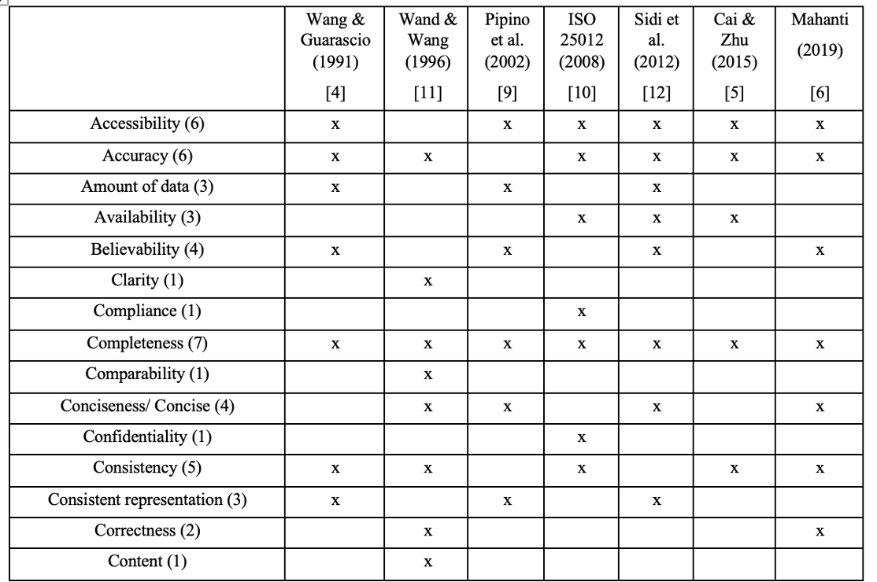
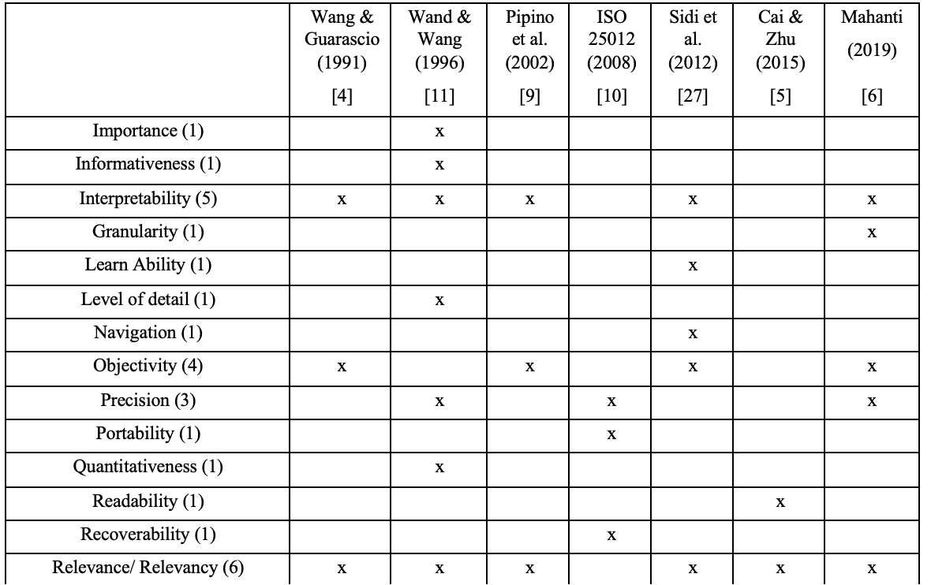
Data Quality Framework for Alternative Fuels
2. Defining Data Quality dimensions – Methodology
•68 papers were initially reviewed, but in the end we only considered articles that:
•Presented a minimum level of detail, clearly defining each dimensions
•Proposed at least 10 dimensions
•Offered new dimensions against previous works.
•Only seven (!) sources met these criteria. Most articles re-arrange, repeat or adjust dimensions that were previously published, offering little novelty.

Slide 22
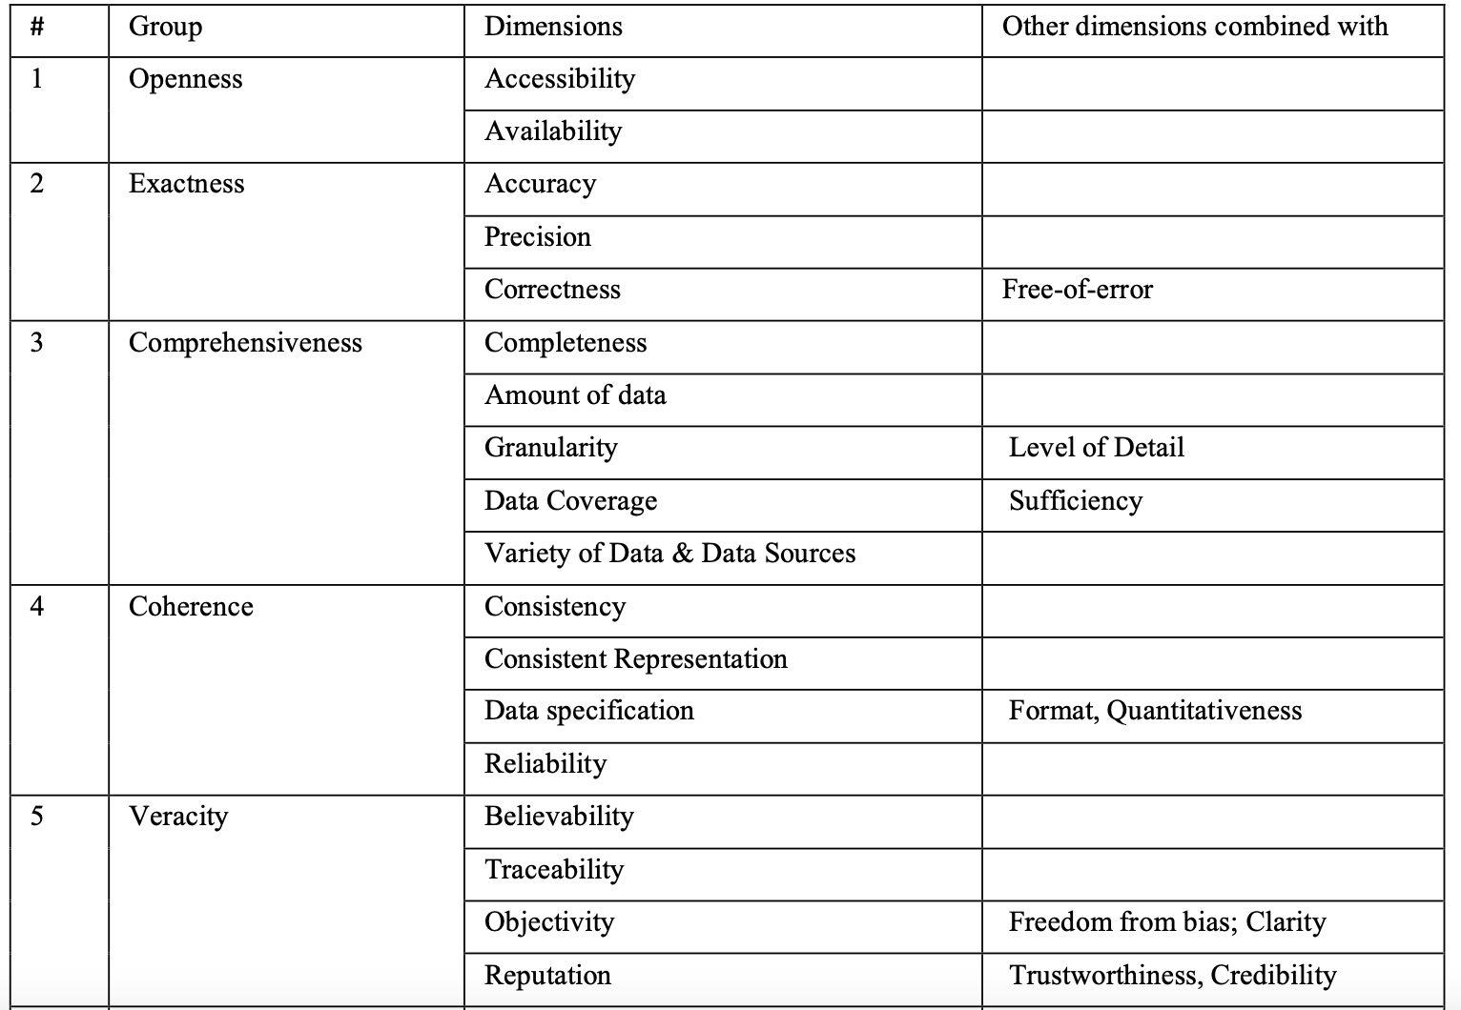
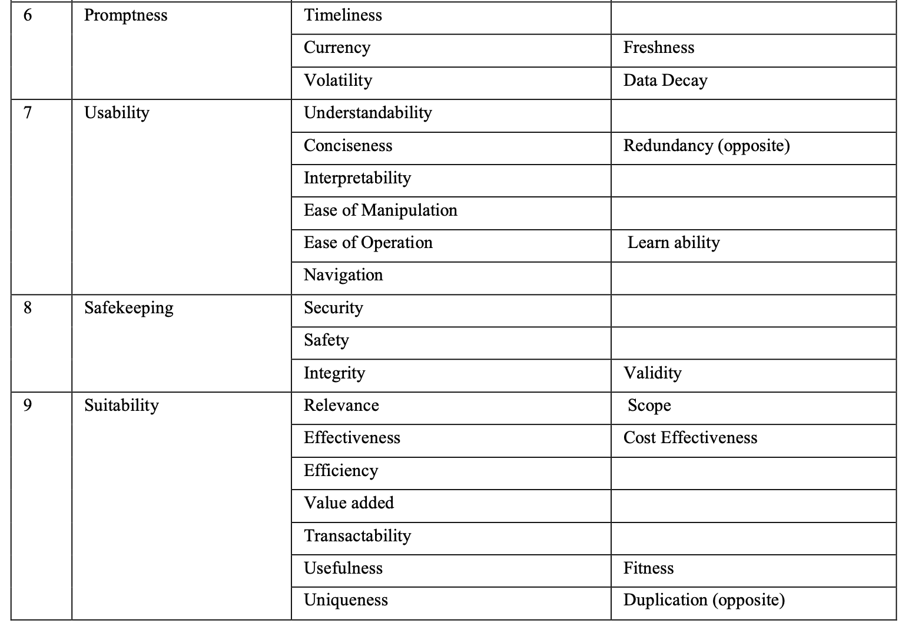
Data Quality Framework for Alternative Fuels
2. Defining Data Quality dimensions – Results

Slide 23
Data Quality Framework for Alternative Fuels
2. Defining Data Quality dimensions – Results
Literature review on quality dimensions (for any use case!)
•Grouping quality dimensions frequently mentioned in scientific literature into 9 “categories”
# | Group | Dimensions
1 | Openness | Accessibility, Availability
2 | Exactness | Accuracy, Precision, Correctness
3 | Comprehensiveness | Completeness, Amount of data, Granularity, Data Coverage, Variety of Data & Data Sources
4 | Coherence | Consistency, Consistent Representation, Data specification, Reliability
5 | Veracity | Believability, Traceability, Objectivity, Reputation
6 | Promptness | Timeliness, Currency, Volatility
7 | Usability | Understandability, Conciseness, Interpretability, Ease of Manipulation, Ease of Operation, Navigation
8 | Safekeeping | Security, Safety, Integrity
9 | Suitability | Relevance, Effectiveness, Efficiency, Value added, Transactability, Usefulness, Uniqueness

Slide 24
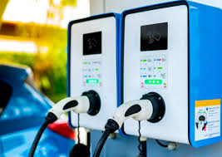
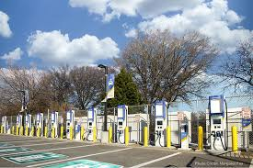
Data Quality Framework for Alternative Fuels
3. Application to AF Data
Which data?
Alternative Fuels
  (Renewable/Sustainable) Energy sources other than conventional fossil fuels
RTTI datatypes referring to Alternative Fuels (2022)
Category | Data type
The types of data on infrastructure | location of recharging points for electric vehicles and conditions for their use
 | location of compressed natural gas, liquefied natural gas, liquefied petroleum gas stations
 | location of refuelling points and stations for all other fuel types
The types of data on the real-time use of the network | availability of recharging points and stations for electric vehicles
 | availability of refuelling points and stations for alternative fuel types
 | price of ad hoc recharging/refuelling
2 categories and 6 datatypes limited to location, availability and price of recharging/ refuelling points
Notes:
We know that alternative fuels refer to (renewable/sustainable) energy sources other than fossil fuels
What exact data in this regard are we looking into?
We looked at legislation (delegated regulations of the ITS directive)
Some data was available in the RTTI, from 2022, namely (table)
However, the RTTI had only 2 categories and 6 datatypes limited to location, availability and price of recharging and refuelling points…
This is limited for building a comprehensive quality framework… (link to next slide)

Slide 25
Data Quality Framework for Alternative Fuels
3. Application to AF Data
Datatypes on the AFIR Implementing and Delegated Acts (Draft) 2025
Category | Data Type
(a) Static data for publicly accessible recharging and refuelling infrastructure for alternative fuels operated by them: | (1) Legal name of the recharging or refueling point operator or owner; (2) Commercial name of the recharging or refueling point operator or owner; (3) Number of recharging or refueling points; (4) Service support; …; (23) Additional information about payment providers accepted; (24) Contract-based (subscription) payment option
(b) Further static data for publicly accessible electric recharging infrastructure operated by them: | (1) Recharging point ID code (connector); (2) Number of connectors; (3) Type of connector (plug); (4) Type of current; …; (9) Smart recharging services; (10) Electricity supplied is 100% renewable
(c) Further static data for publicly accessible hydrogen refuelling infrastructure operated by them: | (1) Hydrogen state; (2) Hydrogen pressure; (3) Daily cumulative capacity; (4) Hydrogen supplied is 100% renewable
(d) Further static data for publicly accessible refuelling infrastructure for liquified methane: | (1) Liquefied methane supplied is 100% renewable
(e) Further static data for publicly accessible refuelling infrastructure for alternative fuels operated by them: | (1) Type of connector (dispenser)
(f) Dynamic data for publicly accessible recharging and refuelling infrastructure for alternative fuels operated by them: | (1) Operational status; (2) Availability; (3) Ad hoc price
(g) Further dynamic data for publicly accessible hydrogen recharging infrastructure operated by them: | (1) Limited amount of hydrogen available
7 categories and 40+ datatypes, including a wider set of dynamic and static information
Notes:
This year, draft versions of the AFIR implementing and Delegated Acts on data have been made available
Now, there is a comprehensive description of AF data
7 categories and more than 40 datatypes include a wider range of dynamic and static information on AF
The table presented is not complete (as it didn’t fit into the slide)
But I bolded some terms so you could see that there are several types in addition to price, location and availability
E.g., type of connector, hydrogen pressure, and so on…
This is the data we considered when developing the framework!

Slide 26
Data Quality Framework for Alternative Fuels
Quality dimensions (for any use case!)
Applying identified dimensions to Alternative
  Tailoring quality dimensions to the context of Alternative Fuels
  Based on inputs from
# | Group | Dimensions
1 | Openness | Accessibility, Availability
2 | Exactness | Accuracy, Precision, Correctness
3 | Comprehensiveness | Completeness, Amount of data, Granularity, Data Coverage, Variety of Data & Data Sources
4 | Coherence | Consistency, Consistent Representation, Data specification, Reliability
5 | Veracity | Believability, Traceability, Objectivity, Reputation
6 | Promptness | Timeliness, Currency, Volatility
7 | Usability | Understandability, Conciseness, Interpretability, Ease of Manipulation, Ease of Operation, Navigation
8 | Safekeeping | Security, Safety, Integrity
9 | Suitability | Relevance, Effectiveness, Efficiency, Value added, Transactability, Usefulness, Uniqueness
SAME AS UVAR
Adapted from: A. M. Carvalho, S. Soares, J. Montenegro, and L. Conceição, “Data Quality: revisiting dimensions towards new framework development,” in 6th International Conference on Industry 4.0 and Smart Manufacturing [in press], 2024.
    ID and Data Collection for Sustainable fuels in Europe (IDACS) project
    Sustainable Transport Forum group (EC)
    Alternative Fuels Infrastructure Regulation (AFIR) and Implementing Act (IA) on data
Notes:
Now we know which data we are dealing with… we need to define our quality criteria
We did the same process from the UVAR DQF – that is – based on the same structuring of quality dimensions
But now, to tailor these quality dimensions to specific AF-related criteria, we based on inputs from:
IDACS project - presentations, reports, and discussion with participants
STF - close contact with the leads of the STF group (EC)
AFIR and IA on data - main inputs came from legislative efforts

Slide 27
Data Quality Framework for Alternative Fuels
Resulting quality criteria (“advanced” draft)
  6 dimensions with applicable criteria
  8 criteria comprising 14 metrics
  Metrics with different formats – numeric, multi-class evaluation, binary
Quality dimension | Quality criterion | Metrics
Correctness | Alignment with IA on data | Percentage of correct data types
Completeness | AFIR data coverage | % Static (general)
 |  | % Static (Recharging)
 |  | % Static (Hydrogen)
 |  | % Static (Methane)
 |  | % Static (refuelling)
 |  | % Dynamic (general)
 |  | % Dynamic (Hydrogen)
Accessibility | Level of accessibility | Multiclass evaluation
 | API availability | Multiclass evaluation
 | NAP accessibility | Binary classification
Currency | Update frequency (static data) | Binary classification
 | Update frequency (dynamic data) | Binary classification
Consistency | Compliance with recommended data standards | Multiclass evaluation
Relevance | Data duplication | Binary classification
Defined particularly for Alternative Fuels data
“Somewhat” similar to UVAR criteria (different metrics)
Very similar to the UVAR criteria
Notes:
… we came up with a first version of the quality criteria for Alternatvie Fuels data
Refer to the numbers
Some criteria have very similar metrics to the ones we had in UVARs, such as:
Level of accessibility and NAP accessibility (accessibility dimension)
Compliance with recommended data standards -> according to the IA on data, AF data should also comply with D2
Binary classification for data duplication –> which can be applied to several datatypes
Other similar criteria were comprised of very different metrics due to the nature of AF data:
The best example is currency dimension, since the recommendations for frequency from the IA on data are rather different from the ones for UVAR
While UVARs mostly deal with static data, AF regards ad hoc price, availability, which are dynamic information
Other criteria were defined particularly for the alternative fuels use case, such as the ones regarding completeness and correctness dimensions

Slide 28
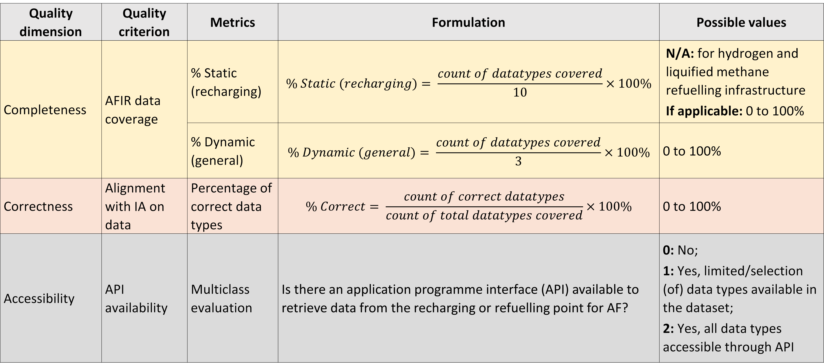
Data Quality Framework for Alternative Fuels
Resulting quality criteria (“advanced draft”)
  Deep-diving into some criteria/metrics…
Nº of “further static datatypes for recharging points”
Quality dimension | Quality criterion | Metrics | Formulation | Possible values
Completeness | AFIR data coverage | % Static (recharging) | $$\% Static (recharging)= \frac{count of datatypes covered}{10}×100\%$$ | N/A: for hydrogen and liquified methane refuelling infrastructure If applicable: 0 to 100%
 |  | % Dynamic (general) | $$\% Dynamic (general)= \frac{count of datatypes covered}{3}×100\%$$ | 0 to 100%
Correctness | Alignment with IA on data | Percentage of correct data types | $$\% Correct= \frac{count of correct datatypes}{count of total datatypes covered}×100\%$$ | 0 to 100%
Accessibility | API availability | Multiclass evaluation | Is there an application programme interface (API) available to retrieve data from the recharging or refuelling point for AF? | 0: No; 1: Yes, limited/selection (of) data types available in the dataset; 2: Yes, all data types accessible through API
Quantitative values
Multiclass evaluation
Requirement from the AFIR IA on data
Notes:
Deep diving into some of our criteria and metrics… especially the ones that were defined particularly for the AF use case
Again, here is a “stretch” of our summary table
Dimension – Criterion – Metrics – Formulation – Possible Values (input values by the evaluator)
Regarding completeness…
Regarding correctness…
Regarding API availability…

Slide 29
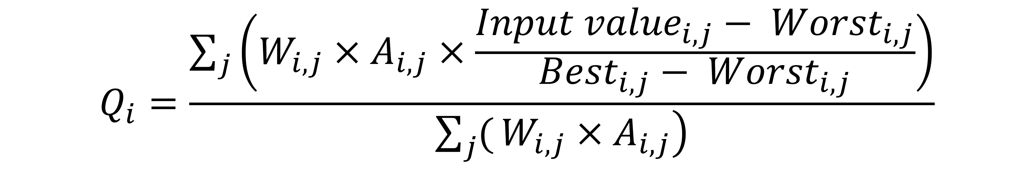
Data Quality Framework for Alternative Fuels
Generic approach (“advanced” draft)
  References: site visits to verify the alignment between the dataset and real-world conditions
  Object: one or several records for a specific recharging or refuelling point
  Recommendations for documentation (reference to MobilityDCAT-AP)
Aggregated view
  Normalization + weighted mean of individual metrics
  Allows to obtain quality indicators for specific dimensions
  Values are computed automatically
  Flexibility – weights are assigned by the evaluator
SAME AS UVAR
Normalization
Weights
$$Q_{i}=\frac{\sum_{j}{\left(W_{i,j}×A_{i,j}×\frac{{Input value}_{i,j}− {Worst}_{i,j}}{{Best}_{i,j}− {Worst}_{i,j}}\right)}}{\left.\sum_{j}{(}W_{i,j}×A_{i,j}\right)}$$
Quality indicator
Notes:
Because of this diversity in metrics, and to be able to compare multiple datasets, we proposed an assessment method to analyse the outcome of the evaluation
There is a generic approach – quite similar for different QFs
And an aggregated view, which:
Normalizes the different metrics and calculates a weighted mean, which results in quality indicators for the different dimensions
We elaborated on an excel sheet that receives the input values from the evaluators, the weights (also received by the NAP operators, and automatically coimputes the quality indicators as output
These are suggestions… evaluators can also use the criteria and adopt a different assessment method

Slide 30
Data Quality Framework for Alternative Fuels
3. Application to AF Data
Final Remarks
Real-world implementation (case study) was not possible
We finalised the quality criteria earlier this year…
…when the draft version of the IA on data was made available
The case study, therefore, was not possible in time
We also struggled to find real-world datasets available to use…
… most charging/fuelling Point operators do not provide their data freely… hindering this exercise
Future work… Maybe for NAPCORE-X?
Notes:
2.5 – Final remarks:
Real-world implementation (case study) was not possible
We finalised the quality criteria earlier this year, when the draft version of the IA on data was made available
The case study, therefore, was not possible in time
Other limitations:
We also struggled to find real-world datasets available to use… most CPOs do not provide data freely, which hindered us from performing the assessment
Future work - Maybe for NAPCORE-X?

Slide 31
Lígia Conceição
Senior ITS Consultant, Armis & NAPCORE
Ligia.conceicao@armis.pt
www.armis.pt

